Slide 1
Digital Portfolio
STUDENT NAME: KRISHNAN S
REGISTER NO AND NMID: 222401219 / asunm11024ai109
DEPARTMENT: Bachelor of Computer Science With Artificial Intelligence
COLLEGE: COLLEGE/ UNIVERSITY : Dharmamurthi Rao Bahadur Calavala Cunnan Chetty’s Hindu College / Madras University

Slide 2
PROJECT TITLE
MY PORTFOLIO

Slide 3


AGENDA
Problem Statement
Project Overview
End Users
Tools and Technologies
Portfolio design and Layout
Features and Functionality
Results and Screenshots
Conclusion
Github Link
3/21/2024 Annual Review

Slide 4

PROBLEM STATEMENT
Many aspiring developers and designers struggle to showcase their skills, personality, and projects in a cohesive and professional way. There is a need for a clean, responsive, and personal online space to demonstrate capabilities to potential employers, collaborators, and clients.

Slide 5

PROJECT OVERVIEW
This portfolio website is a personal project built using HTML and CSS,
focusing on: Presenting the creator (Krishnan) as a Frontend Developer | Designer | Learner.
Showcasing projects like a Personal Blog, Responsive Portfolio, and an AI-driven environmental intelligence tool.
Providing a clean and engaging design with subtle animations to enhance user experience.

Slide 6

WHO ARE THE END USERS?
Recruiters looking to understand the candidate’s technical and design skills.
Clients or collaborators seeking freelance or project-based talent.
Peers and mentors who want to explore your learning journey.
Anyone interested in web development or design inspiration.

Slide 7

TOOLS AND TECHNIQUES
Languages Used: HTML5, CSS3
Design Style: Minimalist and responsive
Techniques: CSS animations for visual appeal.
Semantic HTML structure for accessibility and SEO. Responsive design techniques for mobile compatibility.

Slide 8
POTFOLIO DESIGN AND LAYOUT
Header: Displays a personal photo, introduction, and navigation menu.
About Section: A narrative introduction expressing personality, values, and goals.
Projects Section: Cards layout with icons and brief descriptions.
Contact Section: Simple contact form for interaction.
Footer: Credits and copyright.
Design Elements:
Profile picture for personalization.Navigation links for easy access.
Smooth fade-in animations for sections.Clean and readable typography.
8

Slide 9
FEATURES AND FUNCTIONALITY
📱 Responsive Design: Works well across devices (desktop, tablet, mobile ).
💬 Contact Form: Allows visitors to send a message directly. 🧠 Project Showcases: Highlights personal projects with concise summaries.
🎨 Personal Branding: Includes a photo and thoughtful “About Me” section.
⚡ Animations: Smooth transitions for a dynamic feel

Slide 10
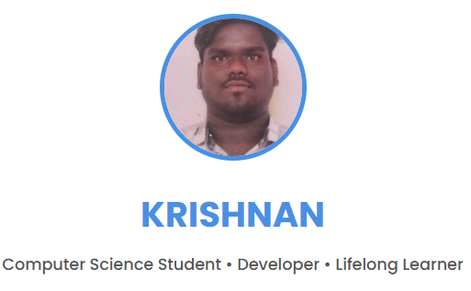

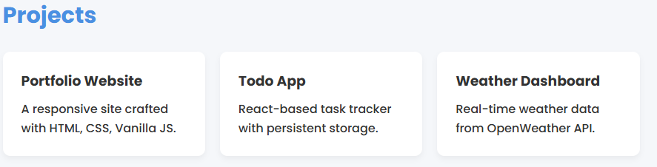
RESULTS AND SCREENSHOTS
3/21/2024 Annual Review
10

Slide 11
CONCLUSION
This portfolio demonstrates Krishnan’s ability to build structured, visually appealing, and user-friendly web pages using foundational web technologies. It highlights a passion for both design and development, and offers a professional yet personal space to showcase talent.
11

